Slide 1
SI
Lecture 17 Oct 25, 2023 Dr. Shafayat Abrar

Slide 2
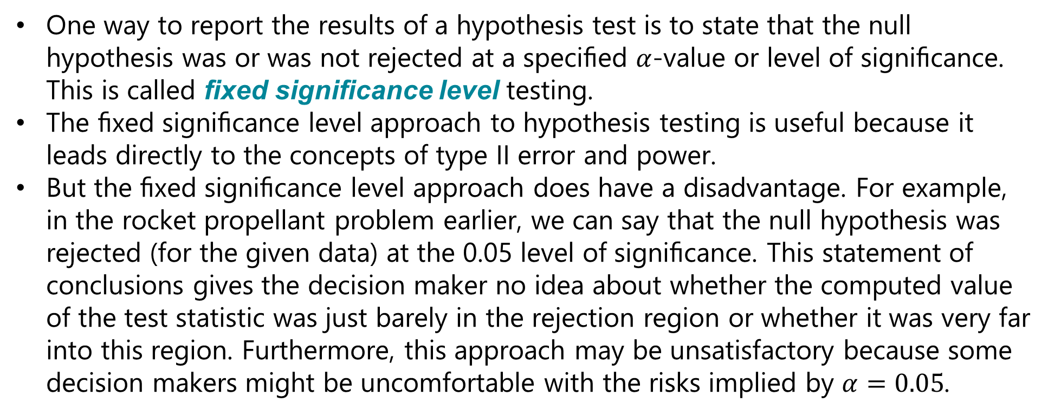
Introduction
One way to report the results of a hypothesis test is to state that the null hypothesis was or was not rejected at a speciﬁed $α$-value or level of signiﬁcance. This is called ﬁxed signiﬁcance level testing.
The ﬁxed signiﬁcance level approach to hypothesis testing is useful because it leads directly to the concepts of type II error and power.
But the ﬁxed signiﬁcance level approach does have a disadvantage. For example, in the rocket propellant problem earlier, we can say that the null hypothesis was rejected (for the given data) at the 0.05 level of signiﬁcance. This statement of conclusions gives the decision maker no idea about whether the computed value of the test statistic was just barely in the rejection region or whether it was very far into this region. Furthermore, this approach may be unsatisfactory because some decision makers might be uncomfortable with the risks implied by $α=0.05$.

Slide 3
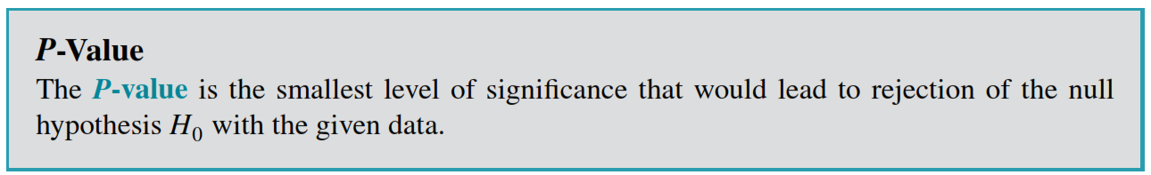
P-Values in Hypothesis Tests
To avoid these diﬃculties, the P-value approach has been adopted widely in practice.
The P-value is the probability that the test statistic will take on a value that is at least as extreme as the observed value of the statistic when the null hypothesis is true.
Thus, a P-value conveys much information about the weight of evidence against the null hypothesis, and so a decision maker can draw a conclusion at any speciﬁed level of signiﬁcance.
A formal deﬁnition of a P-value.

Slide 4
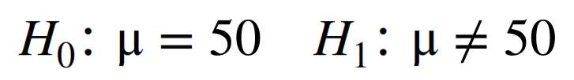
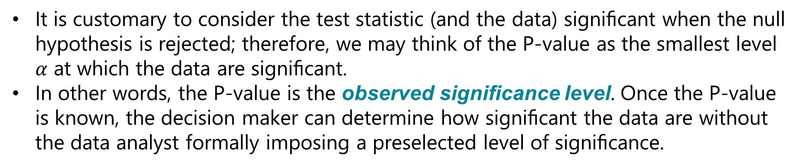
P-Values in Hypothesis Tests
It is customary to consider the test statistic (and the data) signiﬁcant when the null hypothesis is rejected; therefore, we may think of the P-value as the smallest level $α$ at which the data are signiﬁcant.
In other words, the P-value is the observed signiﬁcance level. Once the P-value is known, the decision maker can determine how signiﬁcant the data are without the data analyst formally imposing a preselected level of signiﬁcance.
Consider the two-sided hypothesis test for burning rate
with $n = 16$and $σ=2.5$. Suppose that the observed sample mean is
$\overline{X}= 51.3$ cm/sec.

Slide 5
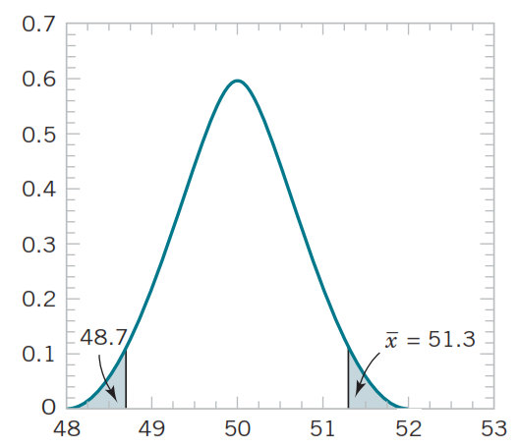
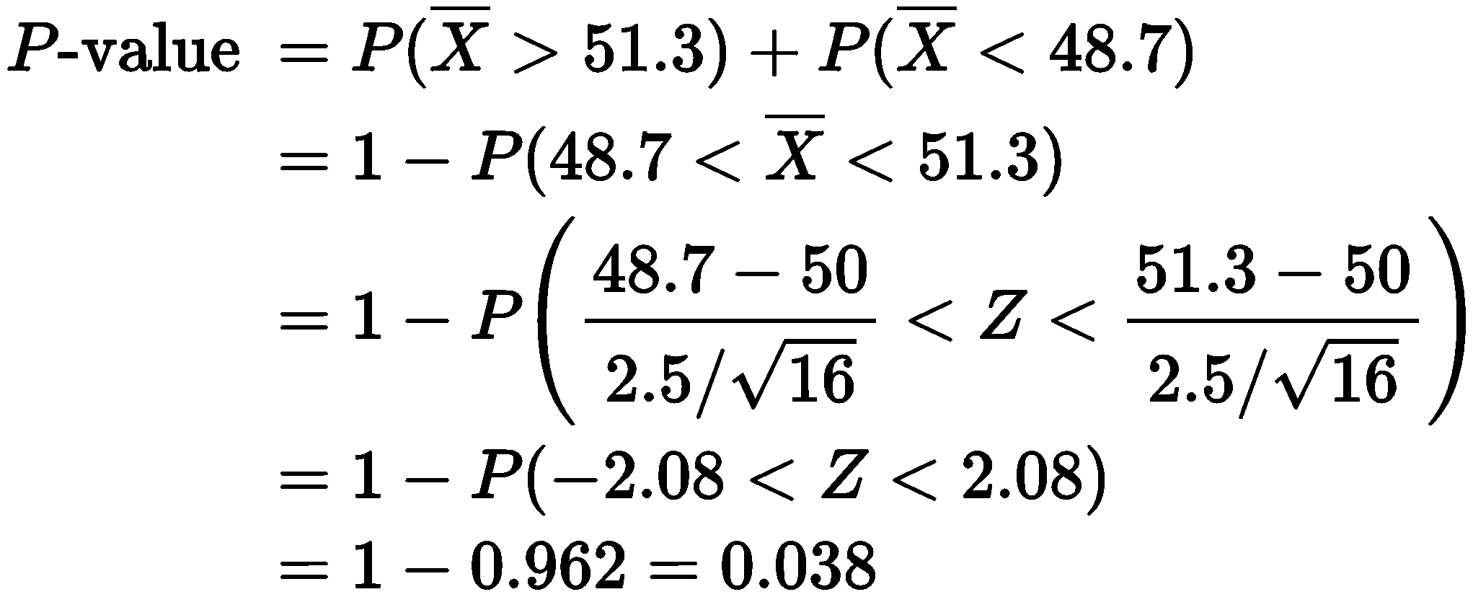
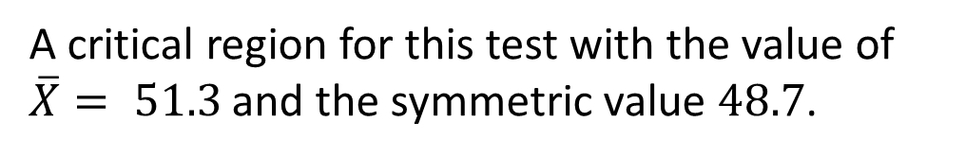

A critical region for this test with the value of
$\overline{X}= 51.3$ and the symmetric value $48.7$.
The P-value of the test is the probability above $51.3$ plus the probability below $48.7$.
The P-value tells us that if the null hypothesis is true, the probability of obtaining a random sample whose mean is at least as far from 50 as 51.3 (or 48.7) is $0.038$.

Slide 6
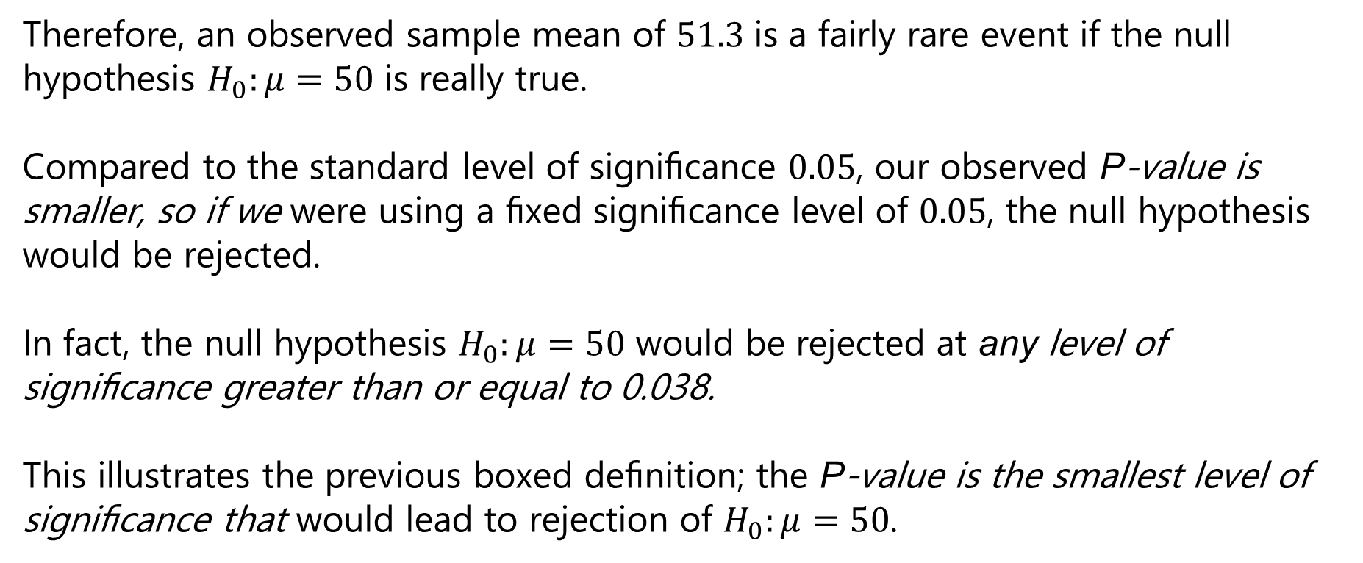
Therefore, an observed sample mean of $51.3$ is a fairly rare event if the null hypothesis $H_{0}:μ=50$ is really true.
Compared to the standard level of signiﬁcance $0.05$, our observed P-value is smaller, so if we were using a ﬁxed signiﬁcance level of $0.05$, the null hypothesis would be rejected.
In fact, the null hypothesis $H_{0}:μ=50$ would be rejected at any level of signiﬁcance greater than or equal to 0.038.
This illustrates the previous boxed deﬁnition; the P-value is the smallest level of signiﬁcance that would lead to rejection of $H_{0}:μ=50$.

Slide 7
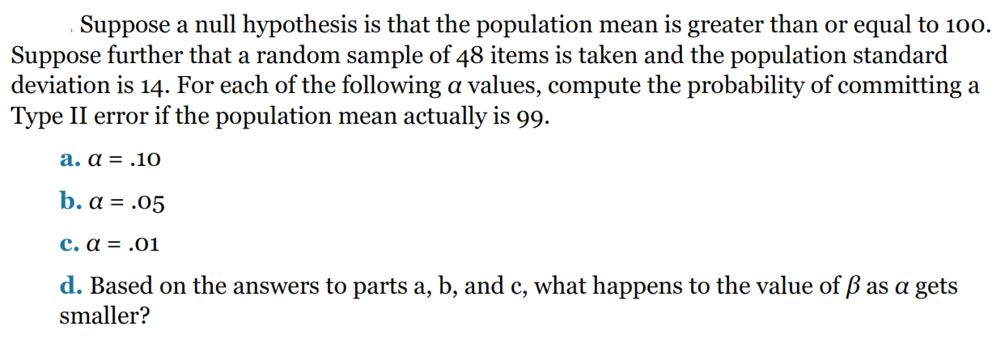
Problem I

Slide 8
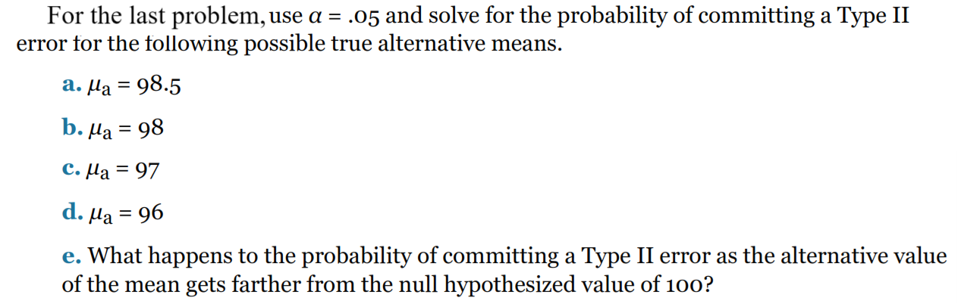
Problem II

Slide 9
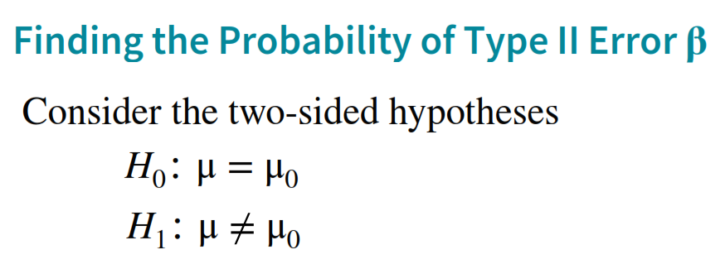
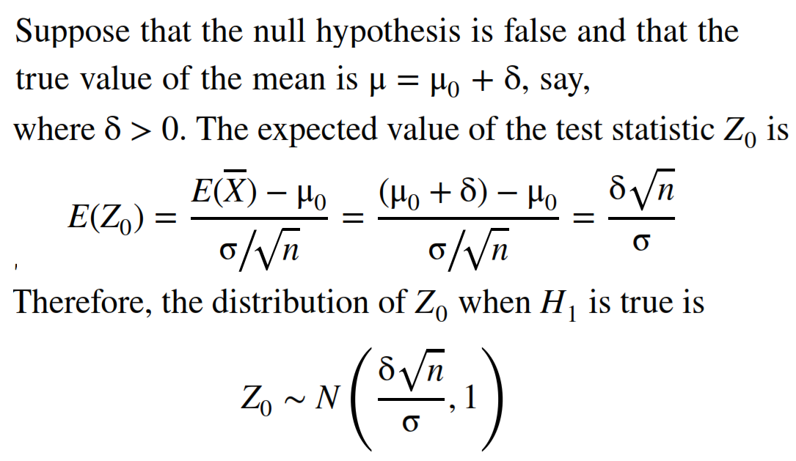

Slide 10
